Slide 1
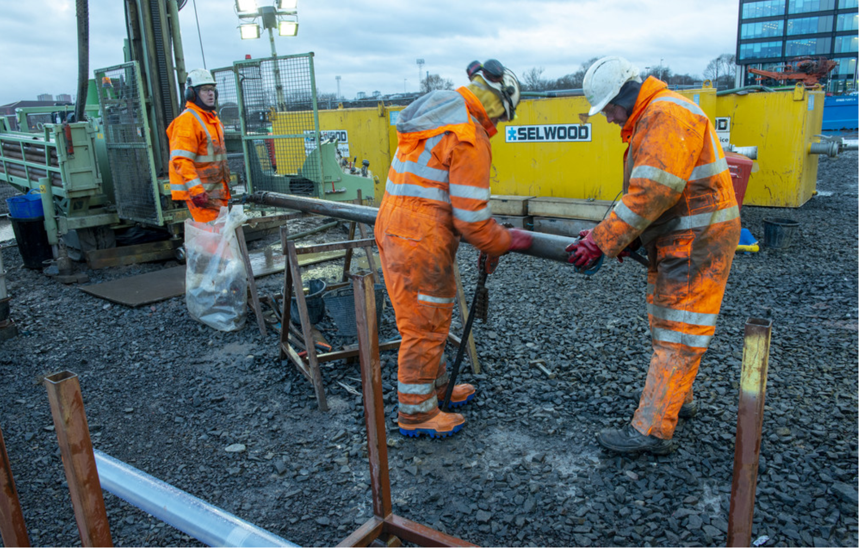
We will begin shortly…

Slide 2
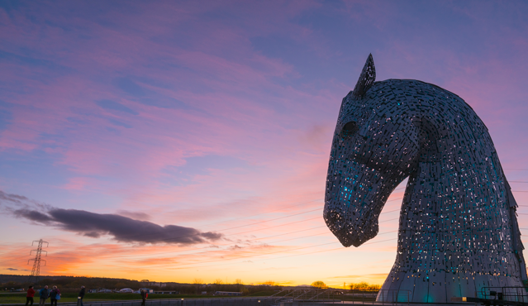
Webinar
Housekeeping
webinar@scotent.co.uk

Slide 3

Joining the webinar
If you’d rather join us via telephone, feel free to do so:
Locate your audio pane.
Click ‘telephone’ from the options.
You will then be prompted, on screen, with the telephone number and access pin.

Slide 4

Asking Questions
Type your questions into the Questions pane of the control panel.
You may send in your questions at any time during the presentation; we will collect these and address them during the Q&A session at the end of today’s presentation.

Slide 5

Have Your Say
We may also seek your input using on-screen polls.
These will appear on screen for a short time and prompt you to participate by giving your opinion.
Select your answer and the webinar will continue as normal afterwards.
Your vote is anonymous and your name and email is hidden.

Slide 6

Recording Notice
Our webinar today is being recorded but your name and attendance is hidden from the recording.
The recording will be uploaded and will be made available to watch again.
Details of how to do this will be shared with you via email, 24 - 48 hours after the webinar has ended.

Slide 7
An Introduction to HotScot

Slide 8
Agenda
Speaker | Topic | Time
Conall McGinley, Low Carbon Specialist, Scottish Enterprise | Introduction and Housekeeping | 10.00-10.05
Jeremy Crooks, Head of Innovation, The Coal Authority | Introduction to the UK opportunity for Minewater Geothermal | 10.05-10.15
Prof. Zoe Shipton, University of Strathclyde | Overview of HotScot proposal | 10.15-10.35
Paul Steen, Head of Department, Ramboll | Overview of potential commercial opportunities for HotScot and Minewater Geothermal | 10.35-10.45
All Speakers | Q&A | 10.45-11.00

Slide 9


Slide 10
Abandoned coal mines - a source of clean energy
Jeremy Crooks Head of Innovation
The Coal Authority

Slide 11
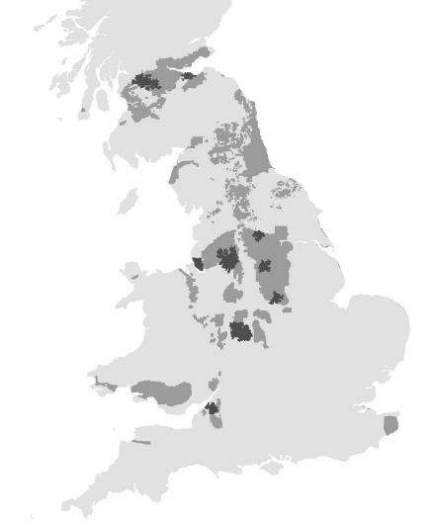
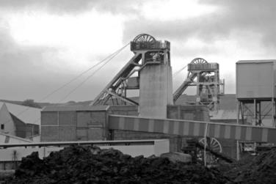
The Coal Authority
Non-departmental Government Body
Created by 1994 Coal Act
Coal Authority own and manage UK coal mines
Glasgow
Edinburgh
Liverpool
Manchester
Birmingham
25% homes and business in coalfields
9:10 largest urban areas (geographical size)
Bristol

Slide 12
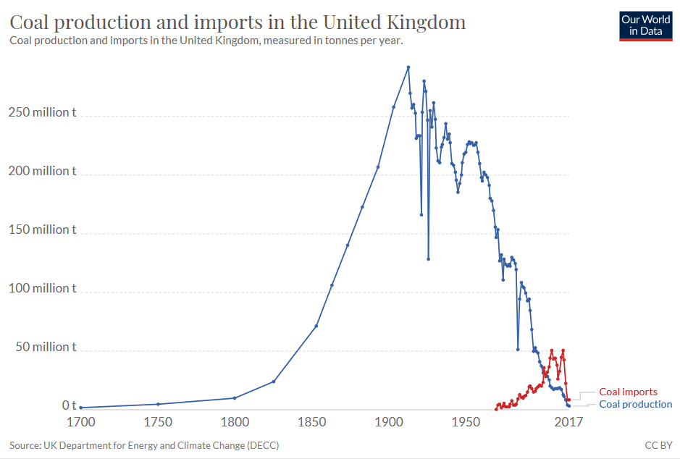
Coal abstraction in the UK

Slide 13
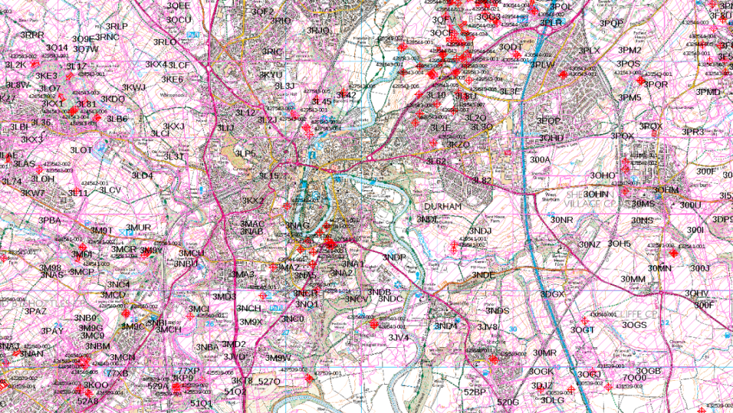
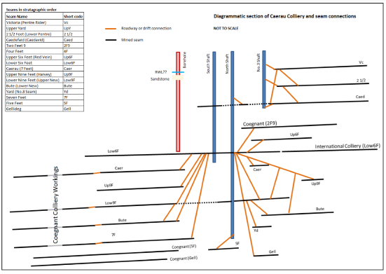
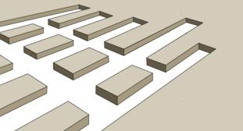
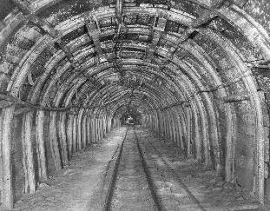
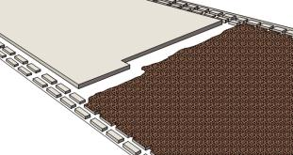
Mine infrastructure
Pillar and stoop
©
Long wall
©

Slide 14
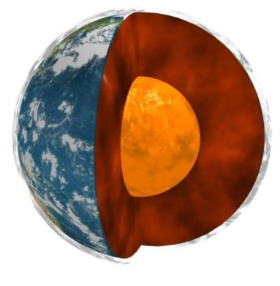
Geothermal energy in abandoned mines
Water level
10-21°C
30-40°C
©
Geothermal heat

Slide 15

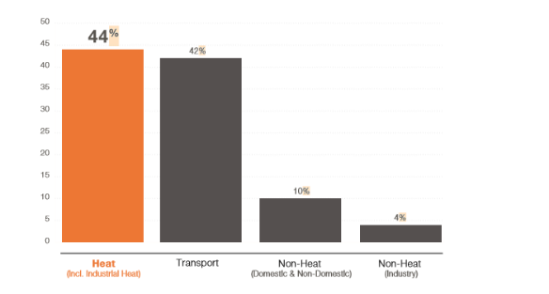
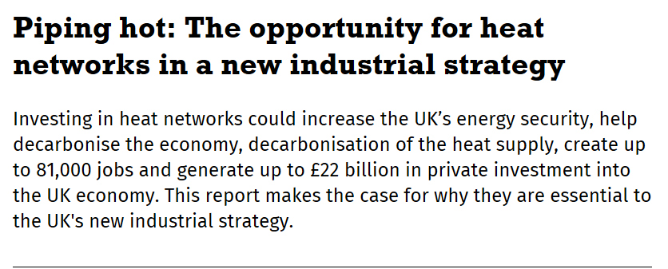
Decarbonising heating
United Kingdom (2017)

Slide 16

The Coal Authority
Could be a few meters
Heat pumps
COP4
or greater
10 - 21°C
Connection path several kms
30 - 40°C

Slide 17
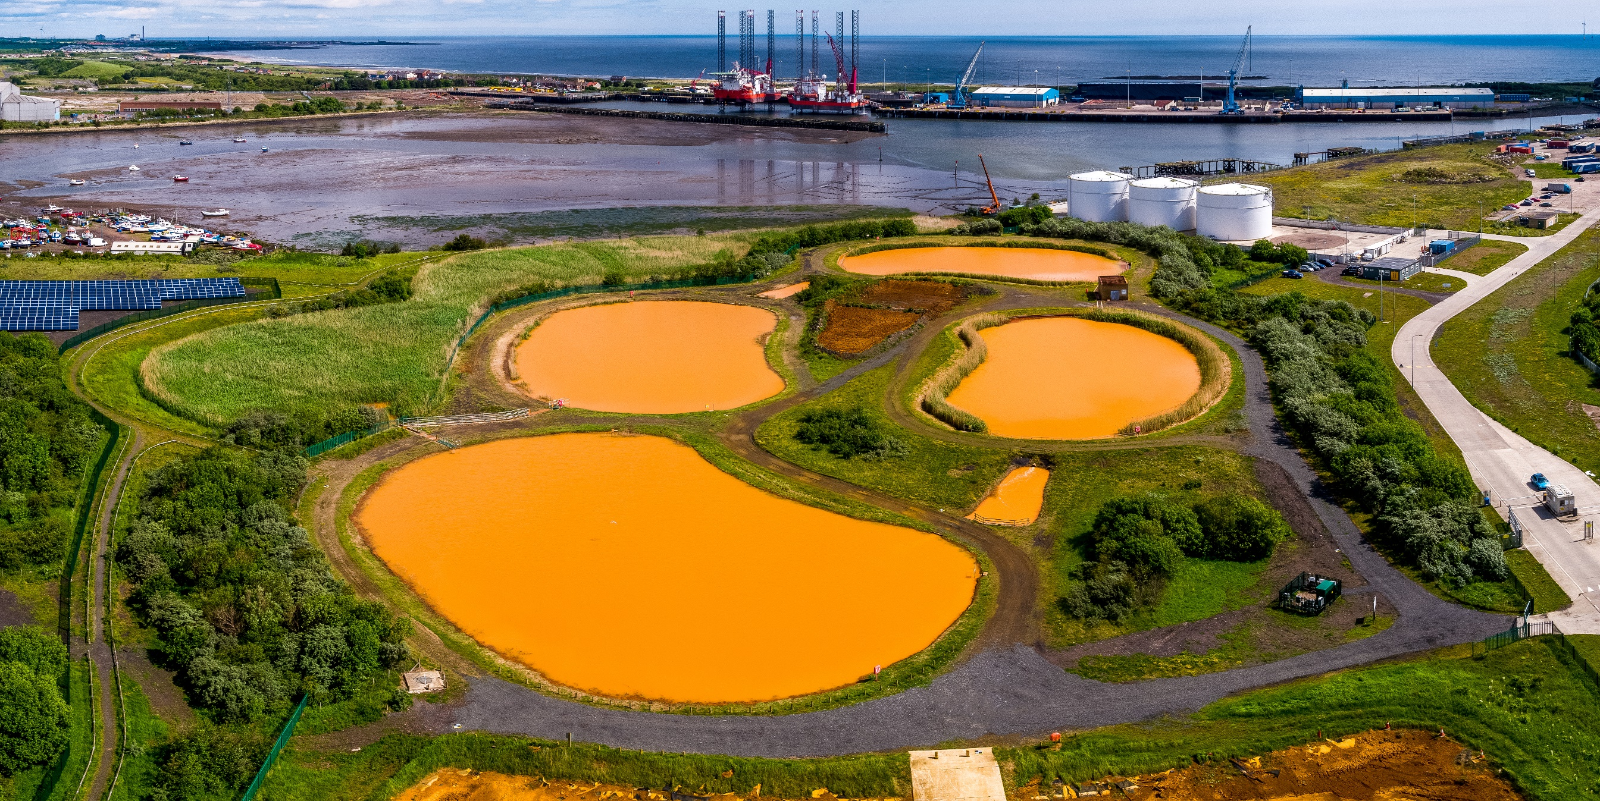
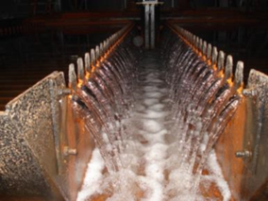
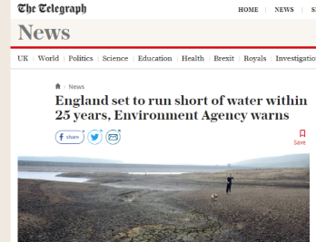
Mine water treatment
122 million m3 treated per annum
34% fresh water
38% brackish
Circa 100MW escaping to atmosphere now!

Slide 18
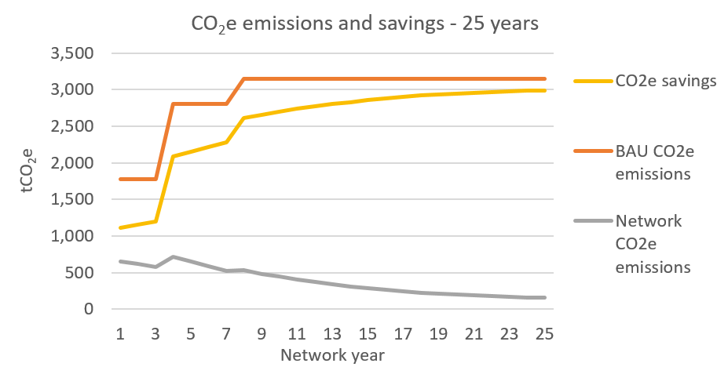
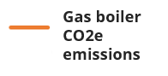

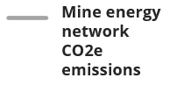
Sustainability
Low temperature network
Stable pricing future proof
Stable temperature
COP4 or greater
32% air quality pollutants from gas heating

Slide 19
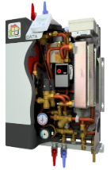
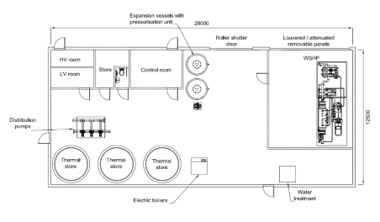
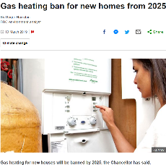
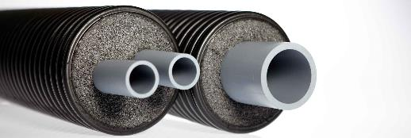
Use in district heating
Heat Interface Unit

Slide 20
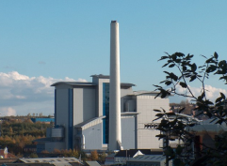
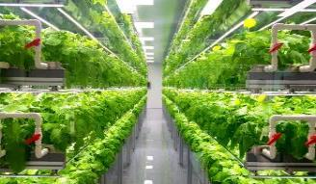
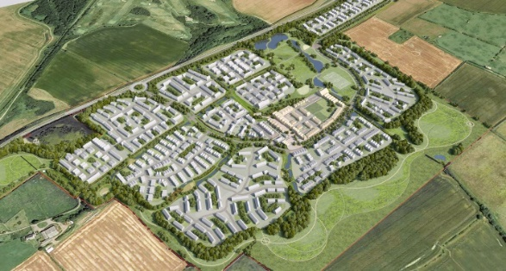

Interseasonal energy storage
Waste heat
Horticulture
Heat networks
Energy from Waste
Cooling
Elevated to circa 40°C

Slide 21

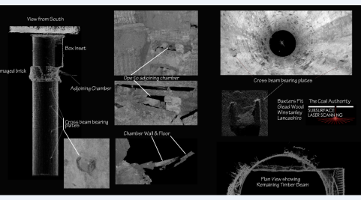
Mine shafts as an energy asset
177,000 known mine entries
Existing access to mine water
Thermal flasks
Hydrogen storage
Dropping weights
90°C
40°C
Thermal storage in abandoned mine shafts
Mine shaft survey

Slide 22
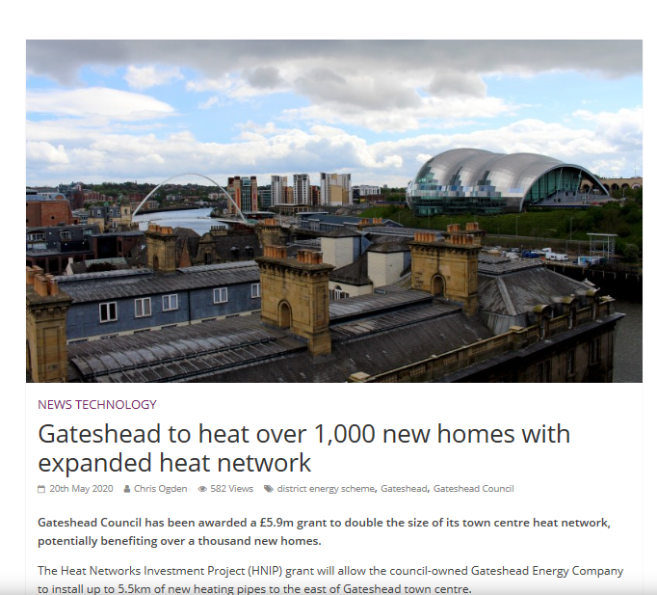

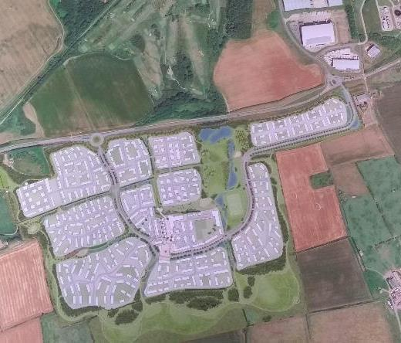

Mine energy schemes
Dawdon MWTS

Slide 23
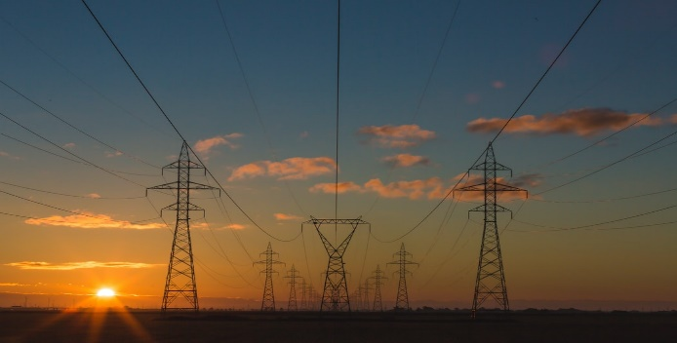


Strategic benefits
Heat
Cooling
Energy storage
Wind turbines – savings/income
Grid balancing
Energy resilience
Food resilience
Water resilience
Climate resilience
Flood resilience
Supply chain
Fuel poverty
Employment
Resilient communities
Commercial advantage

Slide 24
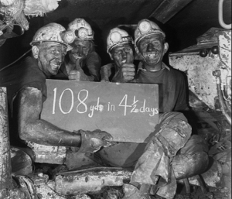
Thank you

Slide 25
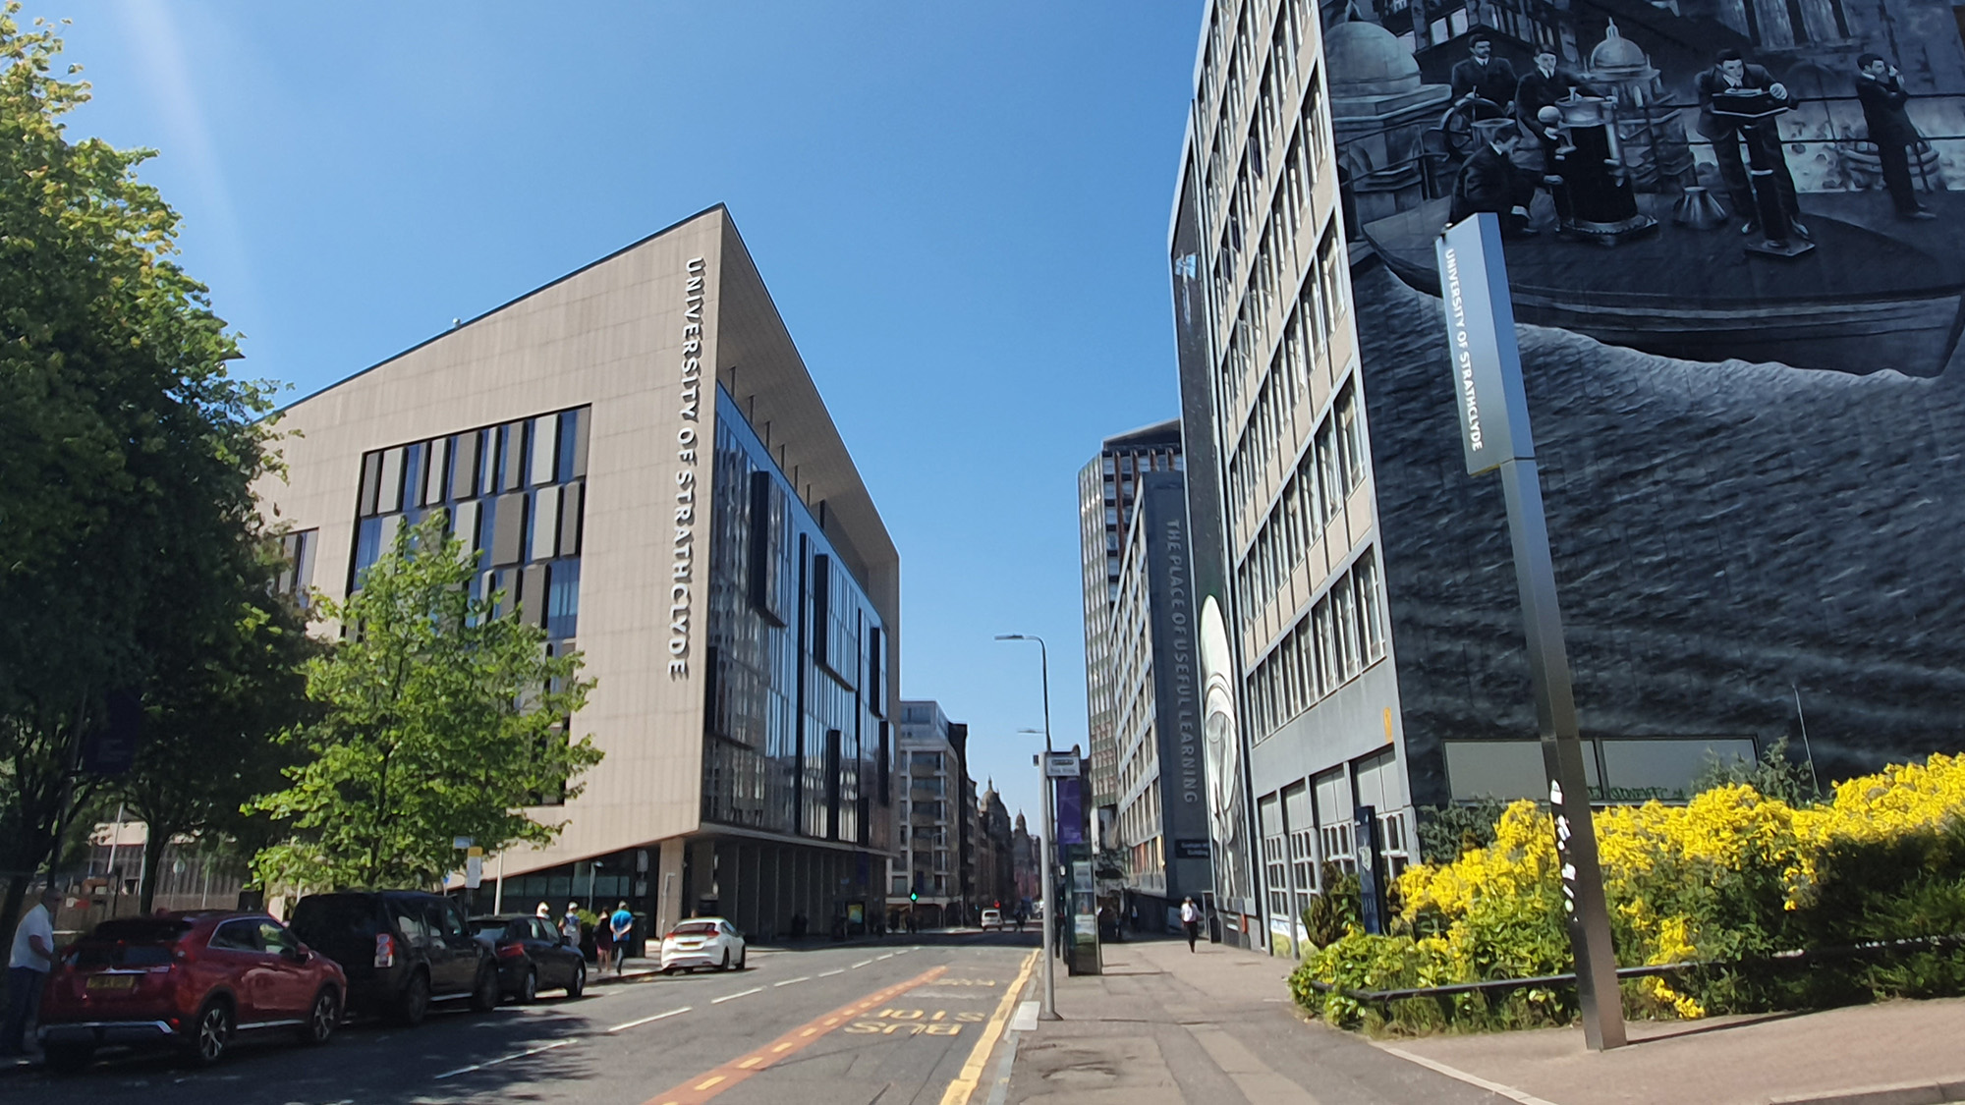


HotScot
Unlocking minewater geothermal resources within former mining areas of Scotland’s Central Belt
X THE PLACE OF USEFUL LEARNING
Mission: to transform Scotland’s mining legacy from a liability into an asset: providing low cost, low carbon heating to homes and businesses. ​

Slide 26

UK Research and Innovation (UKRI) Strength in Places Fund
“HotScot” one of 17 projects to receive £50k through the second round of SIPF
Consortium can apply for up to 5 years funding of £10-50 million
Key objectives of Strength in Places are: ​
Contribute towards significant, relative regional economic growth​
Excellent research and high-quality innovation completed
To enhance collaborations between local businesses, research organisations & local leadership​
To provide a robust evidence base around the impact of locally targeted R&D spending in the UK​
Bid submitted Nov 2020; decision April 2021; project start Summer 2021 for 5 years
https://www.ukri.org/funding/funding-opportunities/strength-in-places-fund/

Slide 27

HotScot Ambitions
Creating a new industry, economic growth and prosperity for the Central Belt of Scotland
Taking on the challenge of low carbon, low cost heating to deliver on national and international climate and poverty targets.
Projects co-designed by the local communities and investing in people through jobs and skills creation
Creative and energy industries, academia, civic leadership, and local communities re-imagining our industrial legacy.
Delivering real-world heating, cooling and energy storage with new products and services.

Slide 28
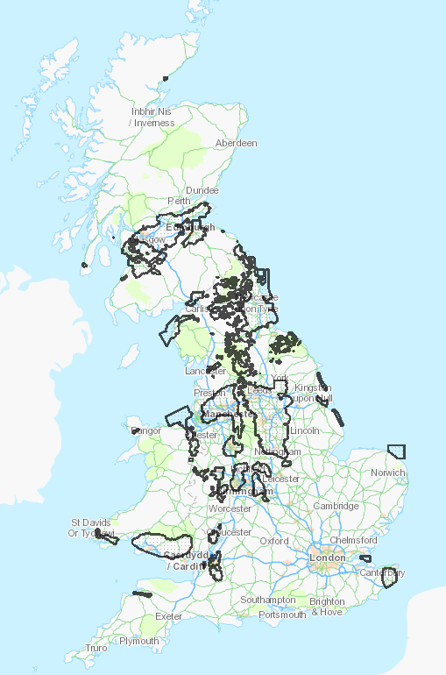
The Opportunity for Minewater Geothermal
Heating = 45% of energy use in the UK
85% of UK households and 65% of non-domestic buildings currently use natural gas
There is a significant coal mining legacy-beneath 25% of UK households
The projected annual cost to decarbonise UK heating from 2019-2050 is £15 billion
With robust legislation planned by SG enacted to meet netzero targets there is the potential for low carbon heat to create approx. 80,000 direct jobs and 120,000 indirect jobs by 2030 in Scotland

Slide 29
Key objectives of HotScot
Delivery of at least three new minewater heating/cooling/heat storage schemes
Deliver infrastructure into a variety of mine types and vintages
Heat networks / energy centres with a variety of domestic and commercial end-users​
Co-construct the designs with local communities, with ongoing access for researchers
Establish what works - demand-side satisfaction surveys and economic impact monitoring
Research and innovation to de-risk minewater heating/cooling/heat storage
Smart: new sensors, data analytics and modelling to optimise energy delivery, track, predict and improve system maintenance, efficiency and demand
First-in-the-world integrated mine energy storage and balancing of heat and coolth requirements
Breaking down regulatory, financial and policy barriers to deployment
Right-sized monitoring strategies and tools to inform operational bounds and mitigate risks
New definitions of minewater plays to enable replicable subsurface appraisal and development approaches
Open access database of geothermal system and heat network data
Best practice stakeholder guidelines for new and retrofit minewater developments
Ensuring legacy and sustainability of minewater sector
​

Slide 30
Anticipated project timeline
HotScot 5 year project envelope
New commercial sites unlocked by HotScot →
✣
Plan.
Small project 1-2 years*
Operational phase
Planning phase
Med project 2-4 years*
Operational phase
Planning phase
Large complex project 4-7+ years *
Operational phase
HotScot research (with Glasgow, Heriot Watt, Stirling, Edinburgh?)
HotScot research
Site appraisal, construction and operational data freely available via UKGEOS.ac.uk data portal (subject to data sharing agreements)
Future funded research and innovation – world-leading national capacity
*length of construction phase at a site vary – many are part-way along the development pathway
✣ transition date from Capital to Operational phase tbc
Capital costs to be part-funded from SIPF with as much co-funding as possible – details tbc
Construction phase research segues into operational stage research – ongoing research funded by future R&I funding and collaborations
Arrows represent research at all stages of the site planning, construction and operations.

Slide 31














Industry-academic partnership
Existing sector supply chain
Technology developers (e.g. sensors)
Energy supply companies (major -> locally owned
Heating and cooling end users (e.g. local authorities, housing developers)
Creative industries - Reimagining low-carbon heating and cooling
Leveraging independent best in field research and innovation
Develop market for minewater heating, cooling and storage
Any questions?
Contact civeng-hotscot@strath.ac.uk

Slide 32

X THE PLACE OF USEFUL LEARNING

Slide 33
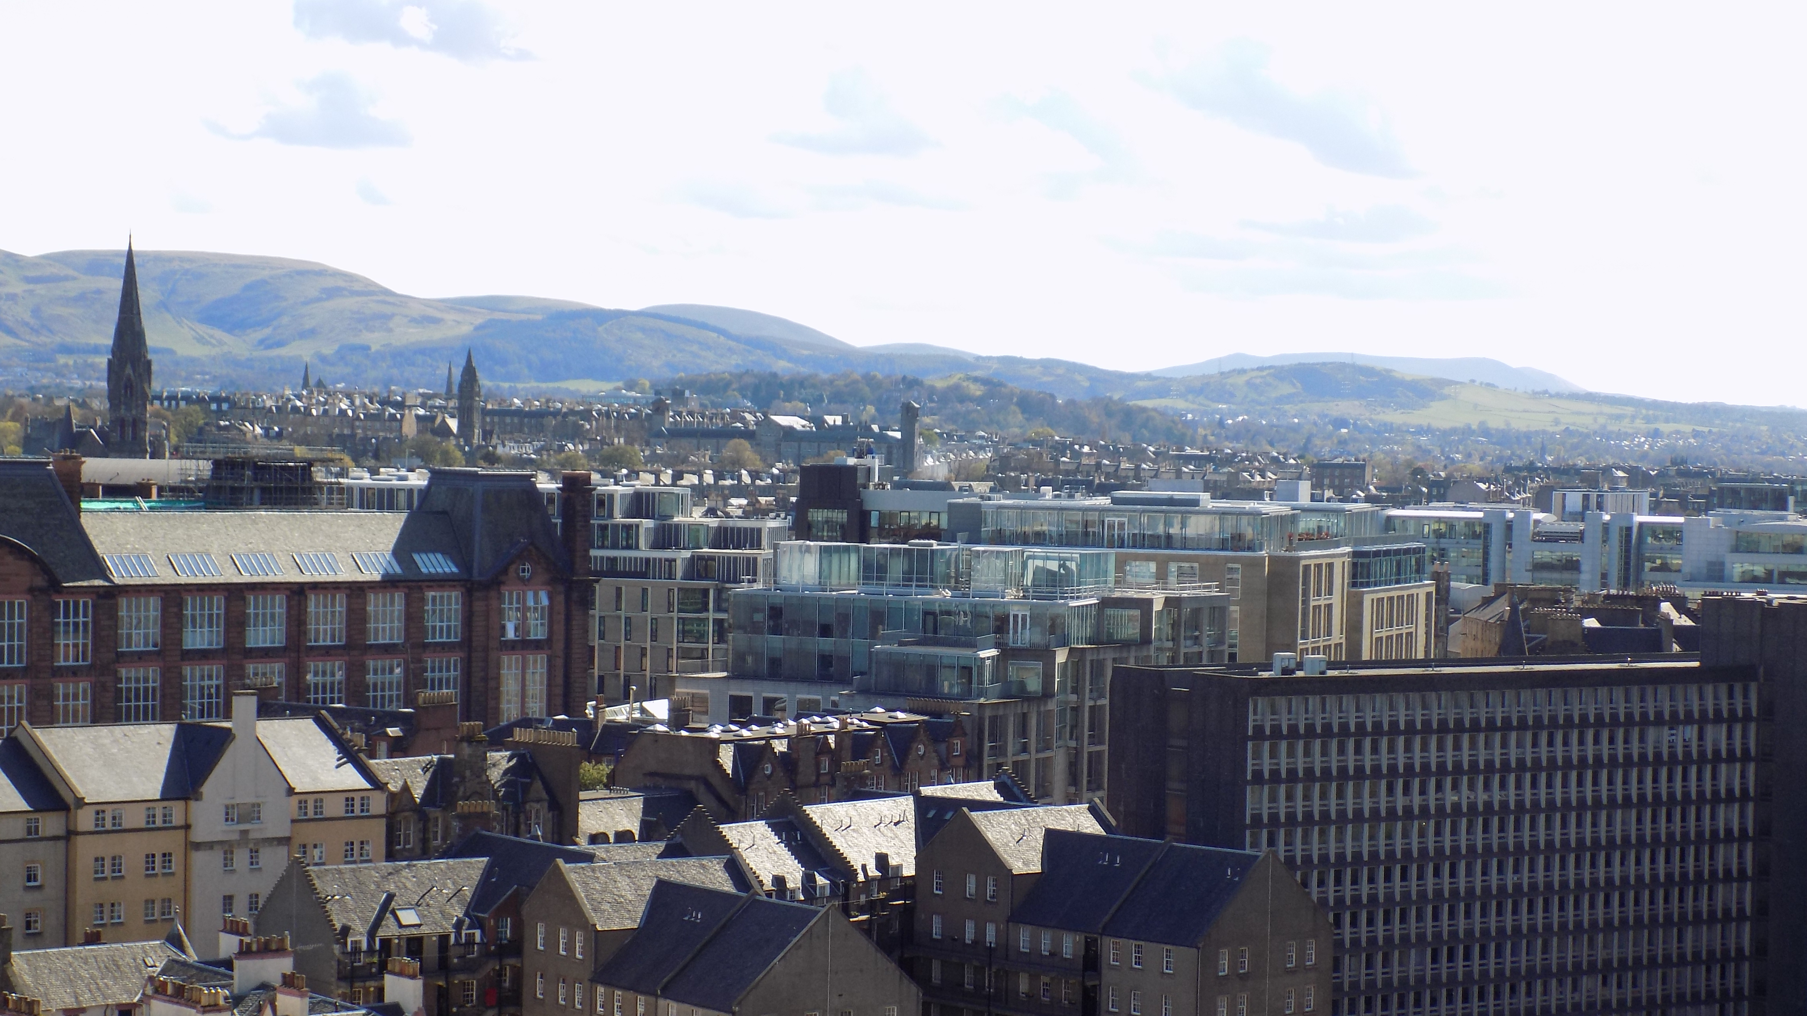
Overview of potential commercial opportunities for HotScot and minewater geothermal
PAUL STEEN
Paul.steen@Ramboll.co.uk
07970 615407

Slide 34

By 2050, low carbon heating will be the norm, and heat networks will constitute a key segment of this
Heat networks industry council launch, 2020
Climate Change (Scotland) Act, 2009
Heat Policy Statement, Towards Decarbonising Heat (2015)
Energy Efficient Scotland (2018)
Climate emergency declared Climate Change (Scotland) Act (2019)
The future of energy in Scotland: Scottish Energy Strategy (2019)
Heat Networks (Scotland) Bill introduced before parliament (2020)
Net Zero Target, 2045
District Heating Loan Fund, 2011
Heat Network (Metering & Billing) Regulations, 2014
Launch of the Domestic RHI, 2014
Publication of Scotland Heat Map, 2014
Launch of the Low Carbon Infrastructure Transition Programme, 2015
Local Heat and Energy Efficiency Strategy pilots, 2016
Consultation on Regulation of District Heating
Energy Efficient Scotland - Transition Programme, 2018
Scotland’s Programme for Government, 2020
Heat Networks, Consultation on Market Framework, 2020
Significant updates to Scotland Heat Map, 2020
Green Heat Networks Fund, 2022
Reduce emissions by 75% by 2030
Incentive | Funding £M | Description
 |  | Scottish Government designated energy efficiency as a national infrastructure priority in June 2015. Energy Efficient Scotland commits to a minimum of £0.5 billion from 2016 to 2020, to support the initial phase of the programme including LHEES pilots over 3 phases.
 |  | District Heating Loan Fund launched in 2011 and offers low-rate, unsecured capital loans to overcome a range of barriers (offered over £15 million to 50 different projects)
 |  | £76M funding Low Carbon Infrastructure Transition Programme (LCITP) £1M development funding in 2020, £20M for social housing and further £60M due to be announced
 |  | £100M over the next five years to a Green Jobs Fund. £2 billion Low Carbon Fund, including: helping to secure investment of £1.6 billion over the next Parliament in heat and energy efficiency in our homes and buildings
Energy Efficient Scotland
£118M per year to 2020
District Heating Loan Fund
£15M
Low Carbon Infrastructure Transition Programme
£76M
£60M
£1M
Scotland’s Programme for Government, 2020
£100M

Slide 35
We have tried to simplify the commercial delivery of a minewater geothermal and district heating system…
INWARD INVESTMENT ANALYSIS
Product and service activities
VALUE CHAIN
A
C
Minewater heat recovery
Energy Centre
(Heat Production)
District Heating Pipe Mains (Transmission)
District Heating Pipe Branches (Distribution)
Customer Connections (Consumption)
1. Design, planning and specification
Geology and hydrogeology, well design, pump selection, water treatment
Energy centre mechanical plant design (including grid connection and considerations about backup fuel sources)
District heating network hydraulics, pipe routing and stress analysis, civil engineering design and specification
District heating network hydraulics, pipe routing and stress analysis, civil engineering design and specification
D
Design of compatible heating system with customer properties
2. Equipment supply and construction
Borehole drilling, pump supply and installation, filtration and water treatment
Plant and equipment supply
Engineering Contractors for energy centre construction and fit out
Civil engineering - trenching and reinstatement
Pre-insulated pipe supply
Pipe installation
Civil engineering - trenching and reinstatement
Pre-insulated pipe supply
Pipe installation
Heat substation / heat interface unit, and heat metering
Borehole operation and maintenance
Energy centre plant operation and maintenance
Contracting in relation to fuel supply
District heating transmission network operator
District heating distribution network operator
Operation and maintenance of systems (including data collection for heat metering and billing)
E
3. Operation and maintenance
4. Investment and ownership
B
Investment in well installation, ownership and operation
Energy centre investment, ownership and operation
Transmission pipe network ownership
Distribution pipe network ownership
Heat supplier to customers
Identified investment opportunities and challenges
0
1
2
3
4
Lacking capabilities/ capacity
Strong capabilities/ capacity
Source: Ramboll illustration

Slide 36
From our experiences of energy system decarbonisation for international cities There are some basic steps that are common to the development of district Energy infrastructure
Understanding the Strategic Context and Creating a Vision | Creating the Institutions and Frameworks for Delivery and Build Skills | Delivering Tactically with a Clear Connection back to the Strategy
Assess the existing energy and climate policy, objectives, strategies and targets and identify catalysts Map local energy demand and evaluate local energy resources Set measurable, reportable and verifiable project indicators | Strengthen or develop the institutional multi-stakeholder coordination framework Integrate District Energy into national and/or local energy strategy and planning Determine relevant policy design considerations Develop locally appropriate procurement option Facilitate finance | Carry out project feasibility and viability that is driven by reducing and decarbonising energy demand Follow the energy hierarchy – energy efficiency first followed by decarbonisation Develop business cases
Notes:
Table, Process, 5

Slide 37
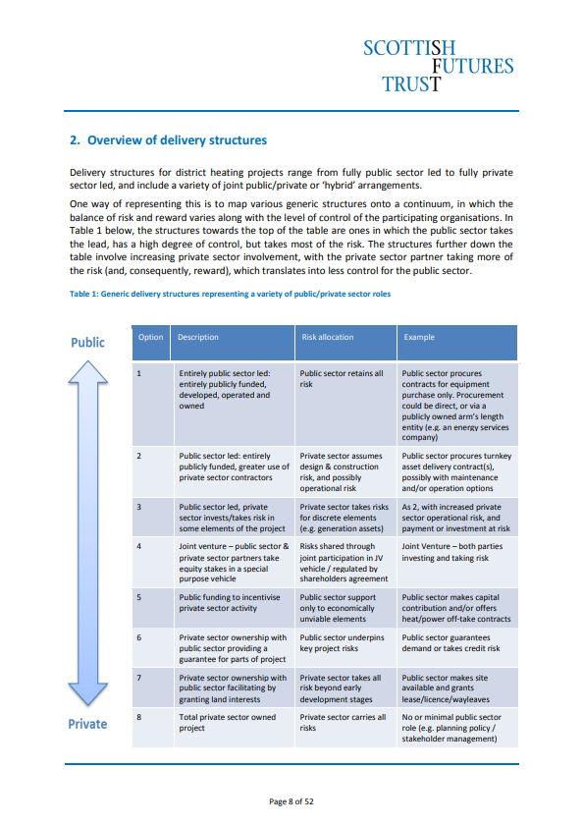

There is no single commercial delivery model and they heavily depend on the balance of risk in the project
Access to and ownership of the minewater resource
Funding for the exploratory work and risk of drilling
Aggregation of heat demands on the system
Investment in a long term infrastructure and patient capital
Long term appetite to supply heating and cooling to customers

Slide 38
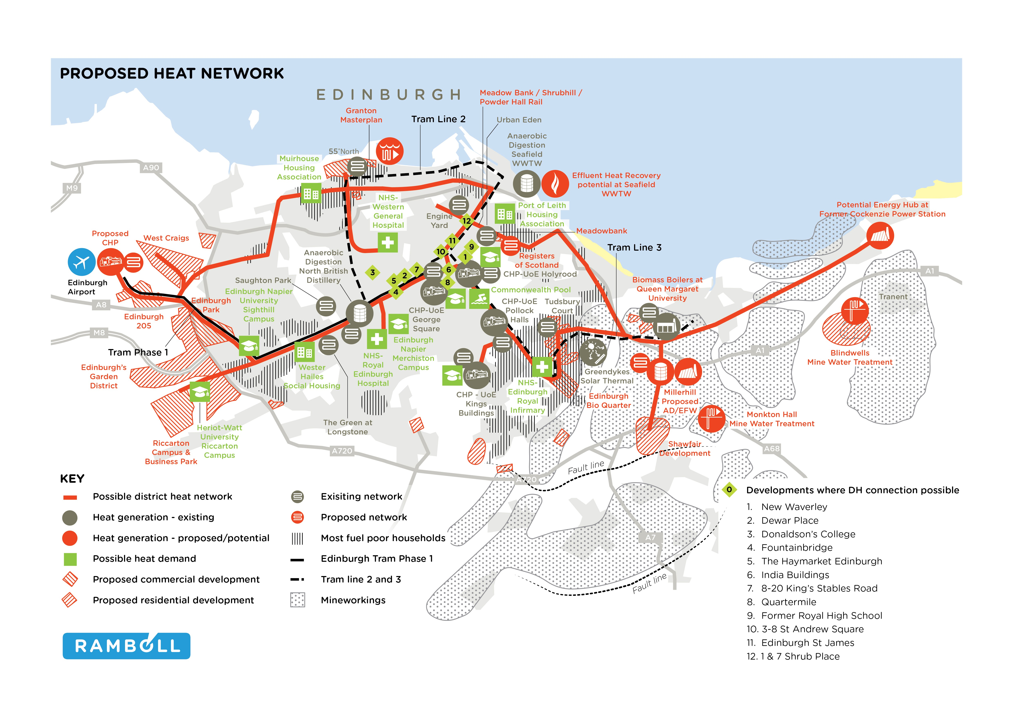

Slide 39
PAUL STEEN
Paul.steen@Ramboll.co.uk
07970 615407

Slide 40
Q&A Session
It’s time for your questions to be put to today’s presenter.
You can still submit a question using the Questions section of your control panel.
Any questions we don’t manage to get to will be followed up with, after the webinar.

Slide 41
Thank you for joining
our webinar.
We’ll email a copy of today’s webinar
to you shortly.

